Slide 1

The National University of Computer and Emerging Sciences
Object Detection
Deep Learning for Perception
Dr. Akhtar Jamil
Department of Computer Science

Slide 2
Goals
Review of Previous Lecture
Today’s Lecture
Faster R-CNN
Fully Convolutional Networks (FCN)

Slide 3
Recap of Previous Lecture

Slide 4
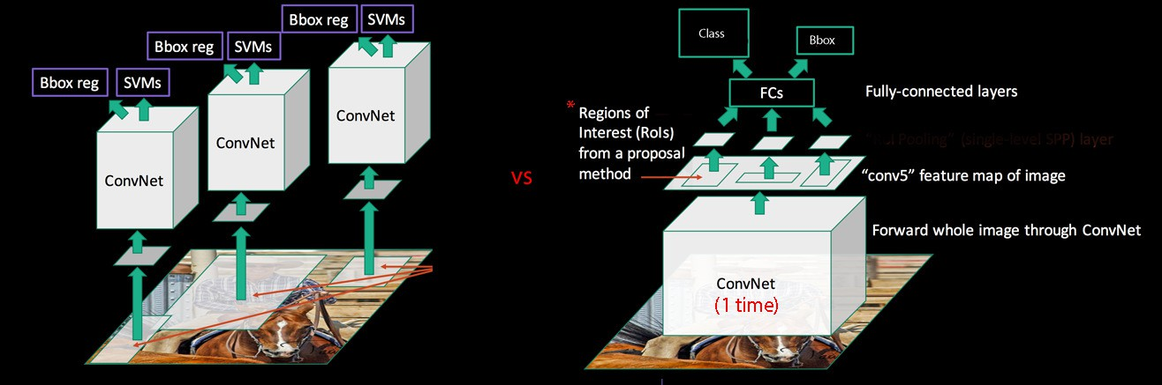
R-CNN vs. Fast R-CNN

Slide 5
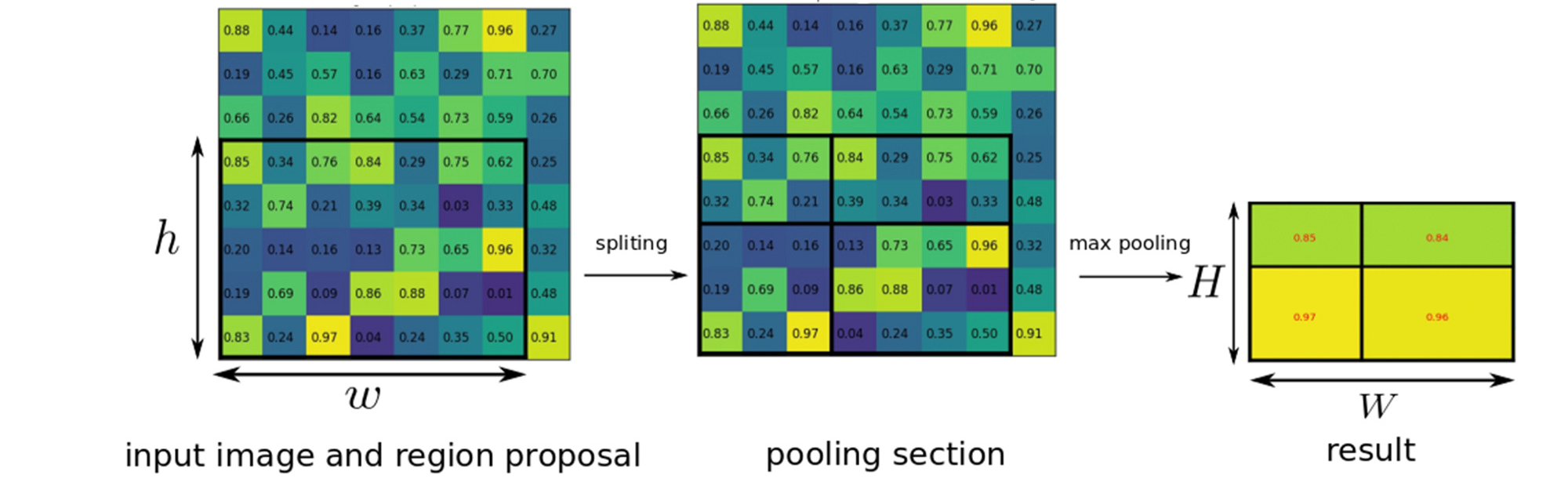
Fast R-CNN: RoI Pooling Example

Slide 6
Today’s Lecture

Slide 7
Faster R-CNN
With all the advancements, there was still one remaining bottleneck in the Fast R-CNN process — the region proposer.
The very first step to detecting the locations of objects is generating a bunch of potential bounding boxes or regions of interest to test.
In Fast R-CNN, these proposals were created using Selective Search, a fairly slow process that was found to be the bottleneck of the overall process.
The insight of Faster R-CNN
Reuse the CNN feature maps for region proposals instead of running a separate selective search algorithm

Slide 8
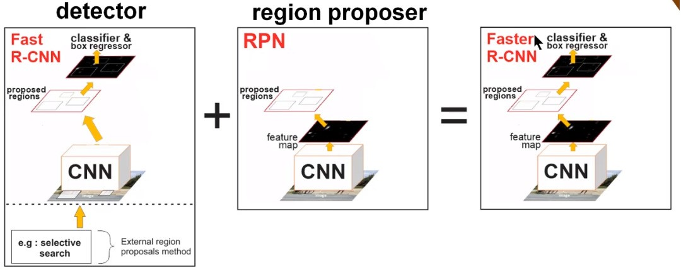
Faster R-CNN
Faster R-CNN has two networks:
Region proposal network (RPN) for generating region proposals
Network using these proposals to detect objects.
Faster R-CNN adds a Network on top of the features of the CNN creating what’s known as the Region Proposal Network.
RPN shares the most computation with the object detection network.

Slide 9
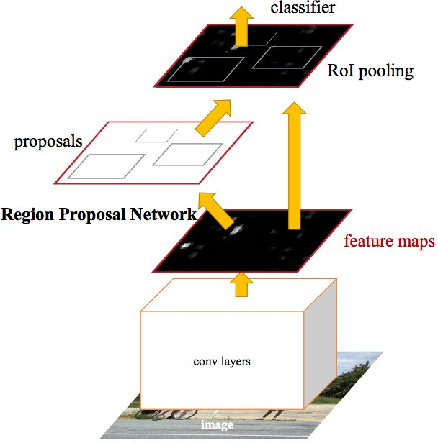
Faster R-CNN
In Faster R-CNN, a single CNN is used for region proposals, and classifications
Inputs: Images
Outputs: Classifications and bounding box coordinates of objects in the images.
Base Network
Faster R-CNN investigates two CNNs
ZFNet (ILSVRC 2013 Winner)
VGG-16 (ILSVRC 2014 Runner-up)

Slide 10
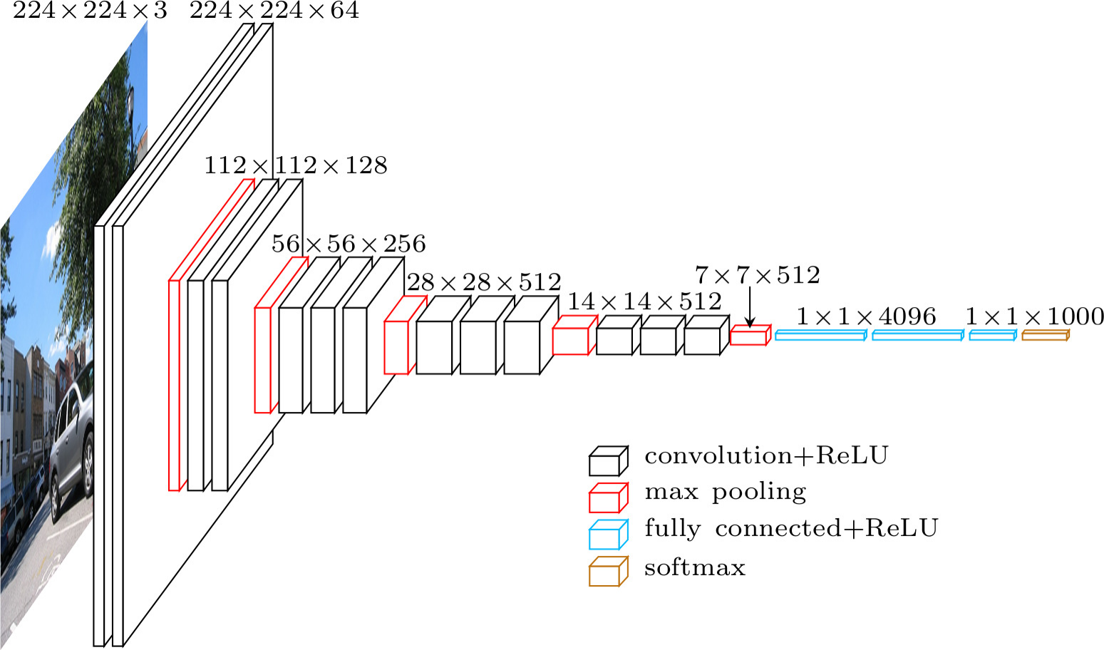
Faster R-CNN
Base Network
VGG-16: The last conv layer has a depth of 512

Slide 11
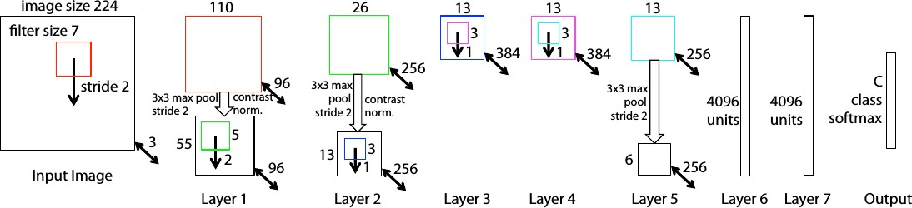
Faster R-CNN
Base Network
ZFNet – An improvement of AlexNet
Last Layer: 256-d

Slide 12
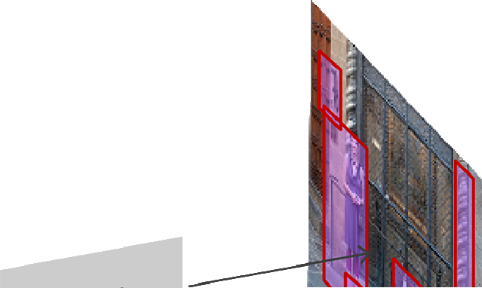
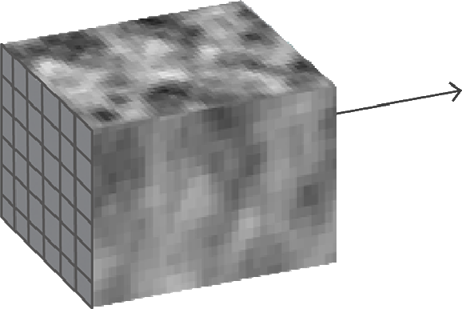

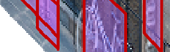
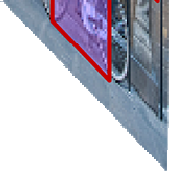
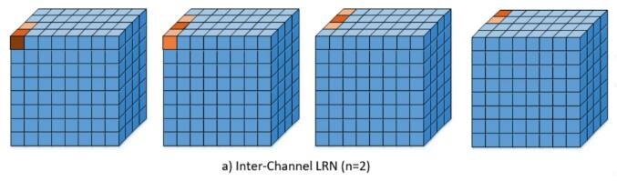
Faster R-CNN
The RPN takes the convolutional feature map and generates proposals over the image
Contrast normalization: Implemented using Local Response Normalization (LRN)
Encourage competition among adjacent neurons in the same layer.
It helps highlight features with strong activation while suppressing weaker ones in a local neighborhood
Enhances feature selectivity and generalization.

Slide 13
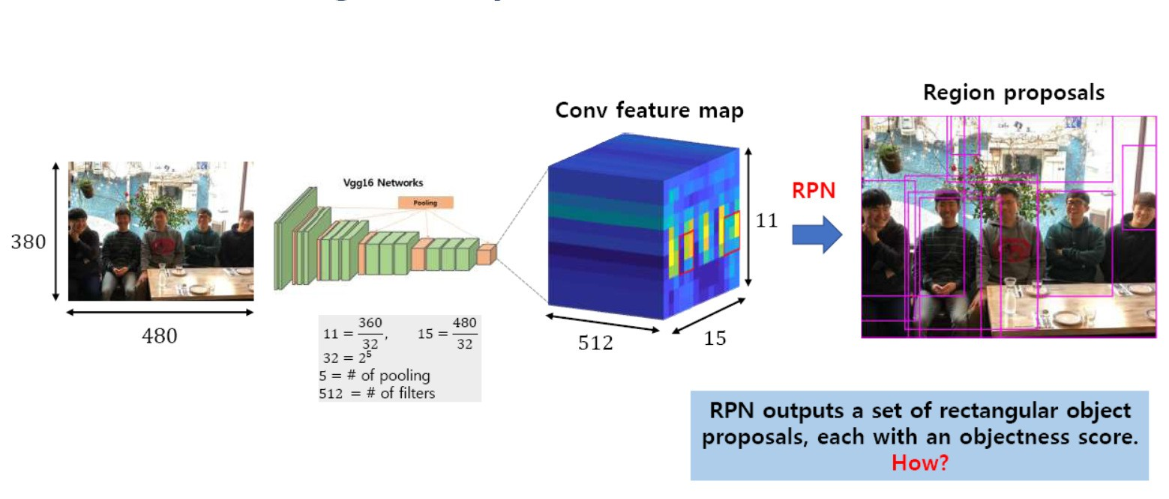
Faster R-CNN
Region Proposal Network
RPN – A network on top of CNN
Input : 480 x 380; Output: 15 x 11 x 512
Each Point in 15x11 is considered as an Anchor

Slide 14
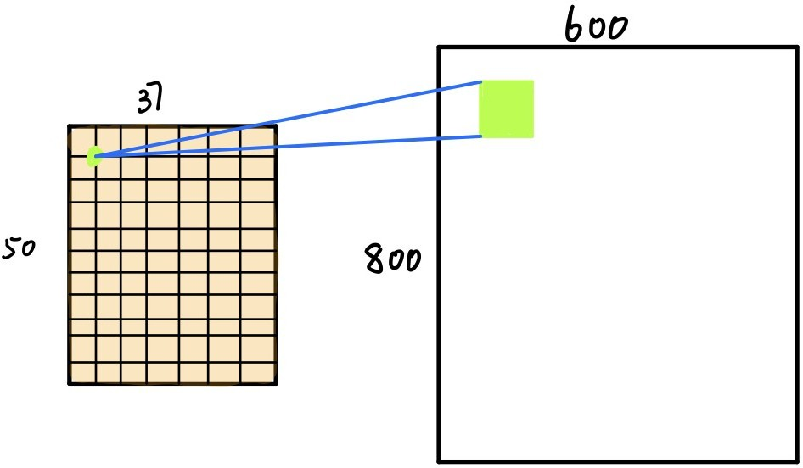
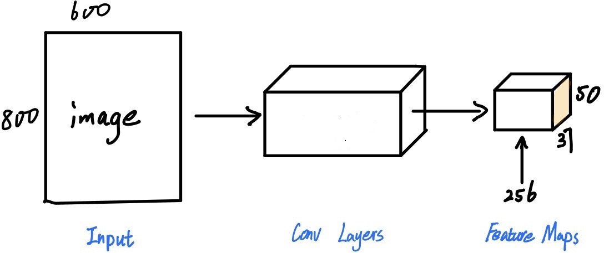
Faster R-CNN
Region Proposal Network
For ZFNet – Depth of output volume is 256
One Anchor projected on the original image

Slide 15
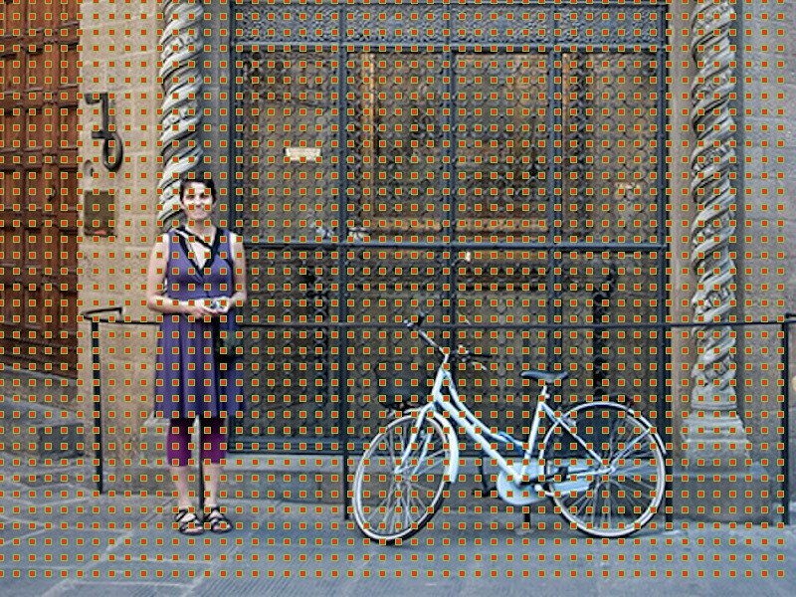
Faster R-CNN
Anchor Centers in Original Image
Source: https://tryolabs.com/blog/2018/01/18/faster-r-cnn-down-the-rabbit-hole-of-modern-object-detection/

Slide 16
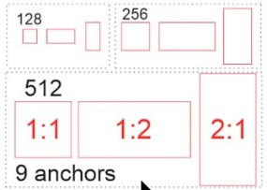
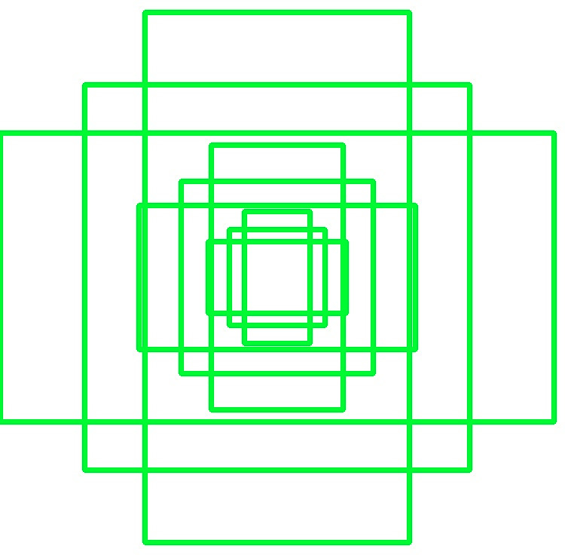
Faster R-CNN
Region Proposal Network
To handle the variations in aspect ratio and scale of objects, Faster R-CNN introduces the idea of anchor boxes.
At each location, the original paper considers:
Three scales: 128x 128, 256×256 and 512×512.
Three aspect ratios: 1:1, 2:1 and 1:2.
At each location – 9 anchor boxes
For each box RPN predicts:
The probability of it being background or foreground.
Location of anchor boxes by application of bounding box regression

Slide 17
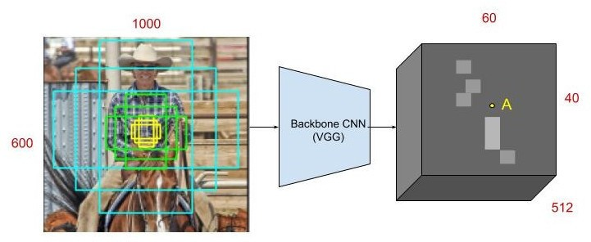
Faster R-CNN
Region Proposal Network

Slide 18
Faster R-CNN
Region Proposal Network
RPN takes all the reference boxes (anchors) and outputs a set of good proposals for objects. It does this by having two different outputs for each of the anchors.
The first one is the probability that an anchor is an object – An “objectness score”
The RPN doesn’t care what class of object it is, only that it does in fact look like an object (and not background).
We are going to use this objectness score to filter out the bad predictions for the second stage.
The second output is the bounding box regression for adjusting the anchors to better fit the object it’s predicting.

Slide 19
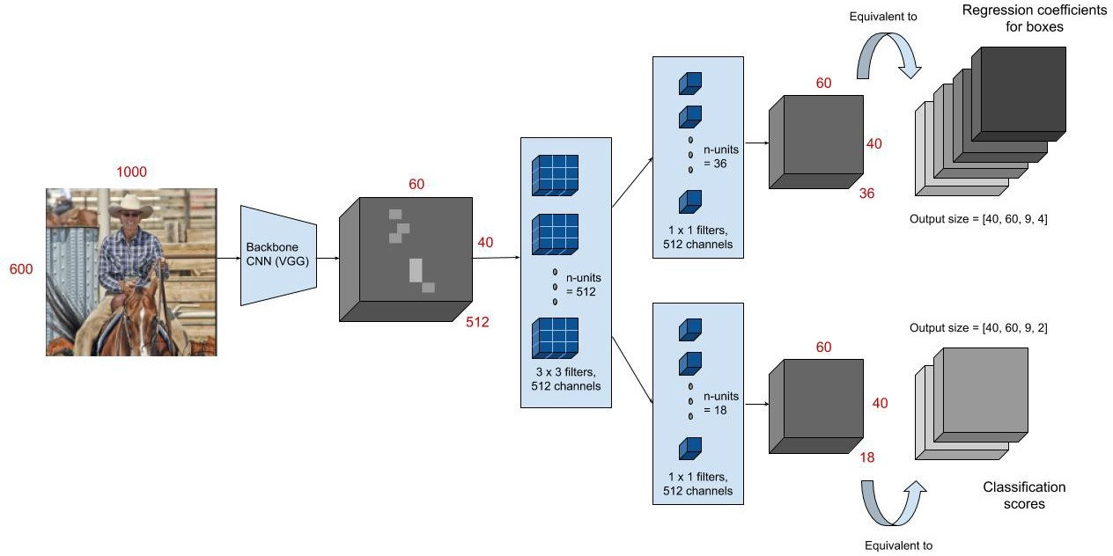
Faster R-CNN
Region Proposal Network
First a 3 x 3 convolution with 512 units is applied to the backbone feature map as shown to give a 512-d feature map for every location.

Slide 20
Faster R-CNN
Region Proposal Network
The convolution is followed by two sibling layers: a 1 x 1 convolution layer with 18 units for object classification, and a 1 x 1 convolution with 36 units for bounding box regression.

Slide 21
Faster R-CNN: RPN
The 18 units in the classification branch give an output of size (H, W, 18). This output is used to give probabilities of whether or not each point in the backbone feature map (size: H x W) contains an object within all 9 of the anchors at that point.

Slide 22
Faster R-CNN
Region Proposal Network
The 36 units in the regression branch give an output of size (H, W, 36). This output is used to give the 4 regression coefficients of each of the 9 anchors for every point in the backbone feature map (size: H x W). These regression coefficients are used to improve the coordinates of the anchors that contain objects.

Slide 23
Faster R-CNN
Region Proposal Network - Summary
At the last layer of an initial CNN – Two conv layers are introduced
A 3x3 sliding window moves across the feature map and maps it to (256-d or 512-d) for each spatial location
This is then fed to the two sibling layers for the two tasks of classification and localization.
Since the task of RPN is to generate potential object like regions classification layer has only two outputs for background and foreground.
In other words, we look at each location in our last feature map and consider k different boxes centered around it
For each of those boxes, we output whether or not we think it contains an
object, and what the coordinates for that box are.

Slide 24
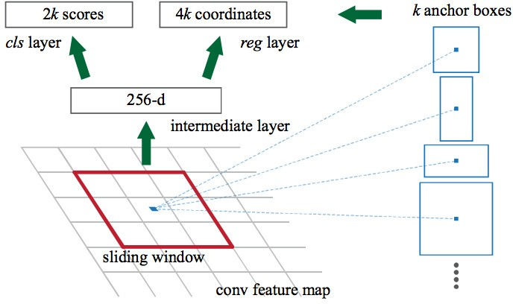


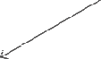
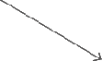


Faster R-CNN
Region Proposal Network
(Or 512-d)

Slide 25
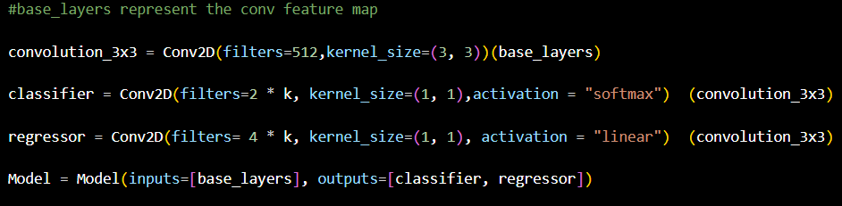
Faster R-CNN
Region Proposal Network

Slide 26
Faster R-CNN
Region Proposal Network
For 9 anchor boxes (k), a total of 36(9k) is the number of outputs for regression layer encoding 4 coordinates for each anchor box and 18(2k) outputs for classification layer that gives an estimate of the probabilities of object or not object for each box.
The 2k scores represent the softmax probability of each of the k bounding boxes being on “object.”
Although the RPN outputs bounding box coordinates, it does not try to classify any potential objects: its sole job is still proposing object regions.
If an anchor box has an “objectness” score above a certain threshold, that box’s coordinates get passed forward as a region proposal.

Slide 27
Faster R-CNN
Region Proposal Network – Non-maxima Suppression
Since anchors usually overlap, proposals end up also overlapping over the same object.
To solve the issue of duplicate proposals we apply Non-Maximum Suppression (NMS).
NMS takes the list of proposals sorted by score and iterates over the sorted list, discarding those proposals that have an IoU larger than some predefined threshold with a proposal that has a higher score.
IoU threshold: Too low and we may end up missing proposals for objects; too high and we could end up with too many proposals for the same object. A value commonly used is 0.6.

Slide 28
Faster R-CNN
Region Proposal Network – Non-maxima Suppression
After applying NMS, we keep the top N proposals sorted by score.
In the original paper N=2000 is used, but it is possible to lower that number to as little as 50 and still get quite good results.
The RPN does two different type of predictions: the binary classification and the bounding box regression adjustment.
For training, we take all the anchors and put them into two different categories.
Those that overlap a ground-truth object with an Intersection over Union (IoU) bigger than 0.5 are considered “foreground” and those that don’t overlap any ground truth object or have less than 0.1 IoU with ground-truth objects are considered “background”.

Slide 29
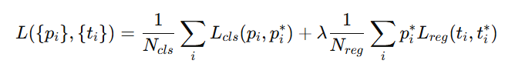
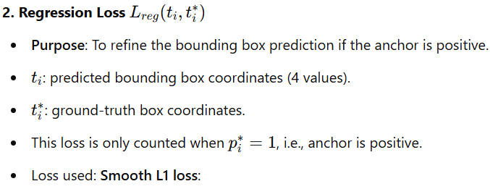
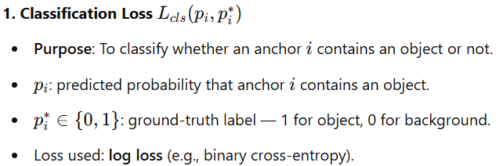
Faster R-CNN Region Proposal Network
Multi-task objective loss function, combines two components:
Classification Loss
Regression (Bounding Box) Loss

Slide 30
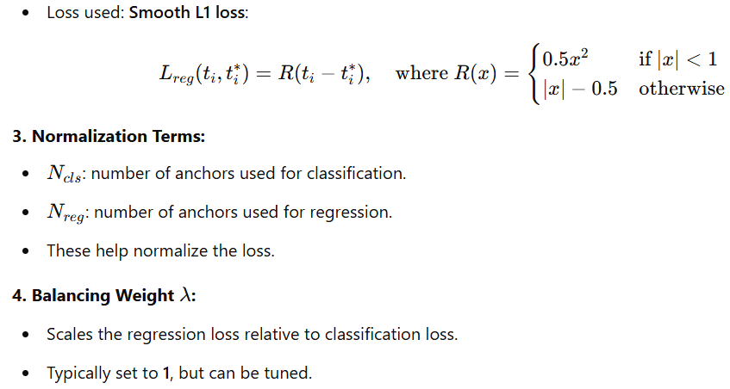
Faster R-CNN Region Proposal Network

Slide 31
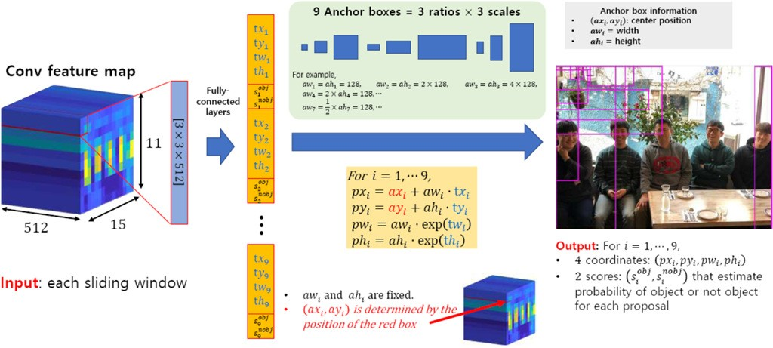
Faster R-CNN: RPN Walkthrough

Slide 32
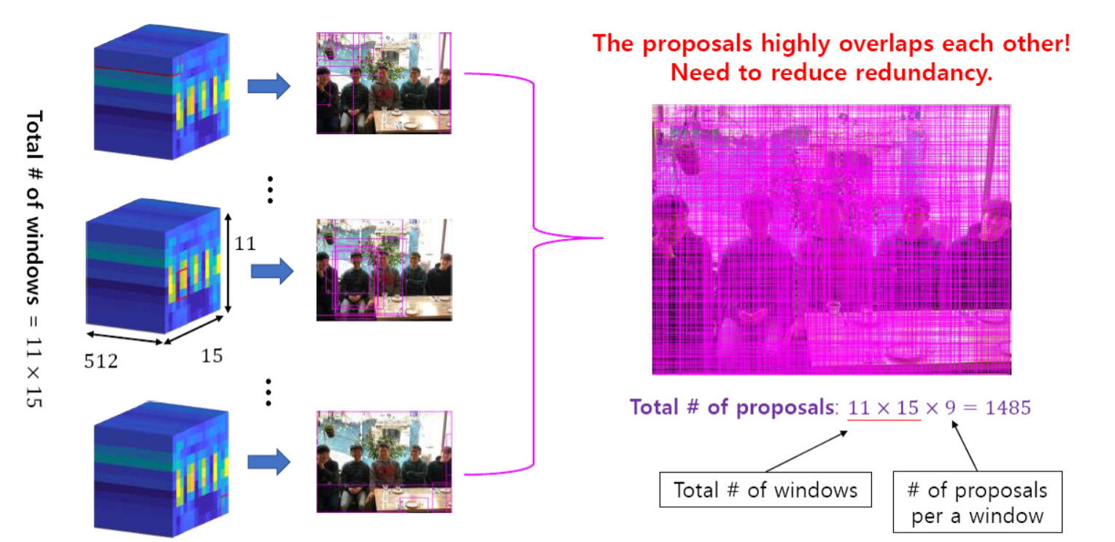
Faster R-CNN: RPN Walkthrough
Reducing Redundancy

Slide 33
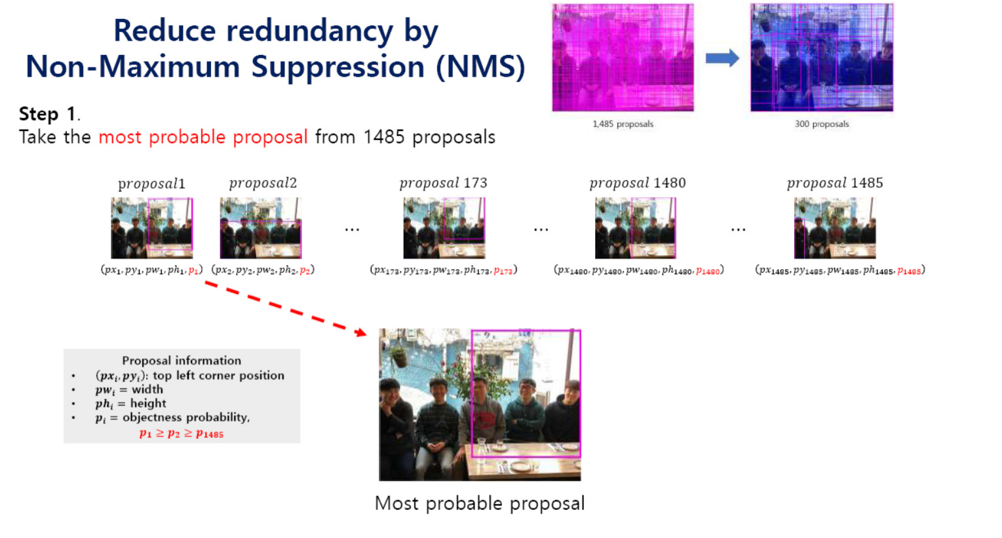
Non-Max Suppression

Slide 34
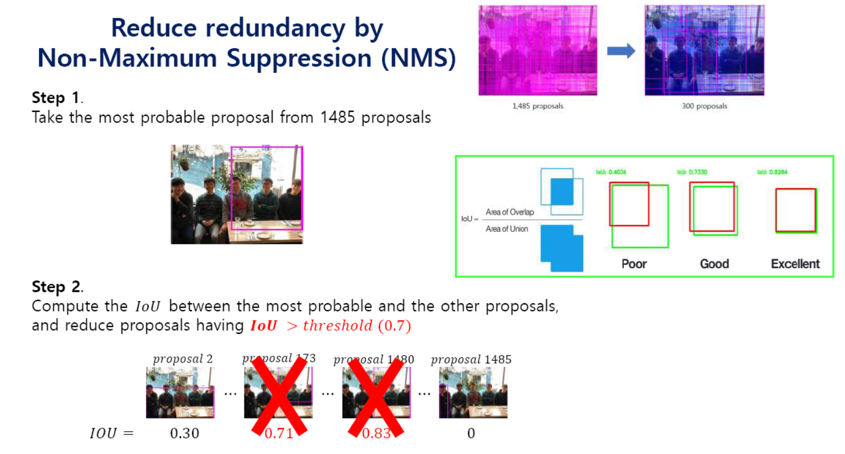

Slide 35
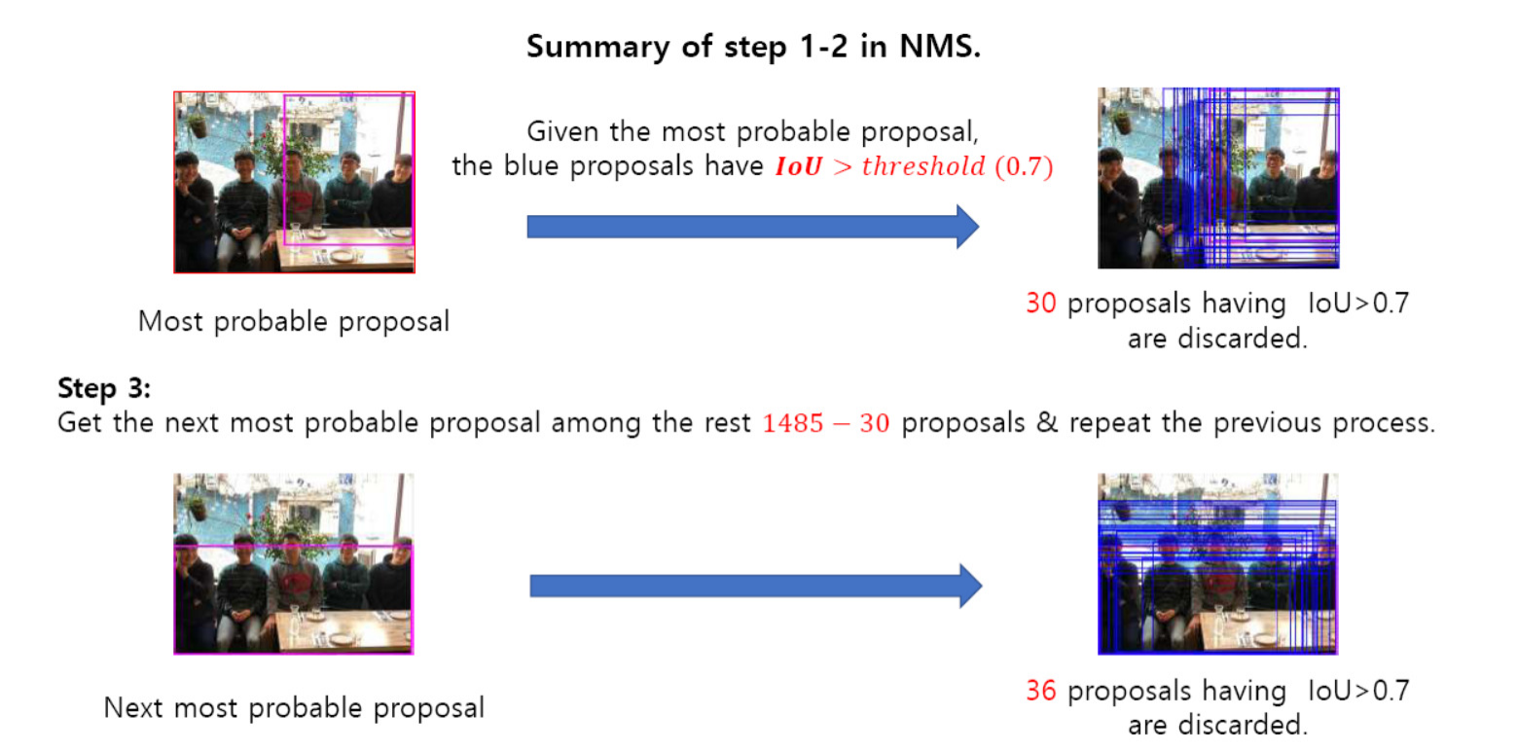

Slide 36
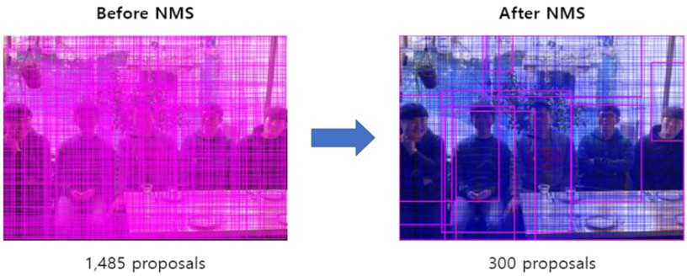
Faster R-CNN: RPN Walkthrough
Repeat the process…

Slide 37
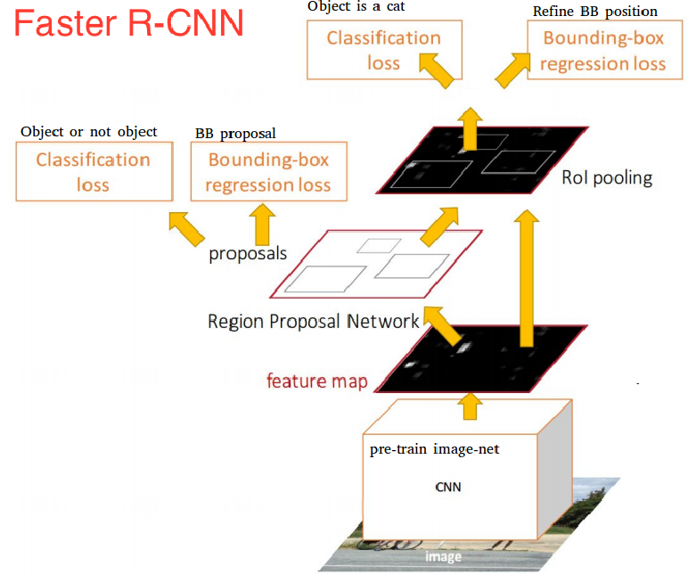
Faster R-CNN: RPN Walkthrough Repeat the process…

Slide 38
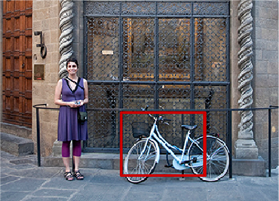
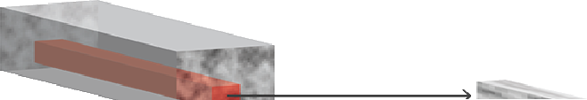

Faster R-CNN
Region of Interest Pooling
Similar to Fast R-CNN
Extract fixed-sized feature maps for each region proposal using region of interest pooling.

Slide 39
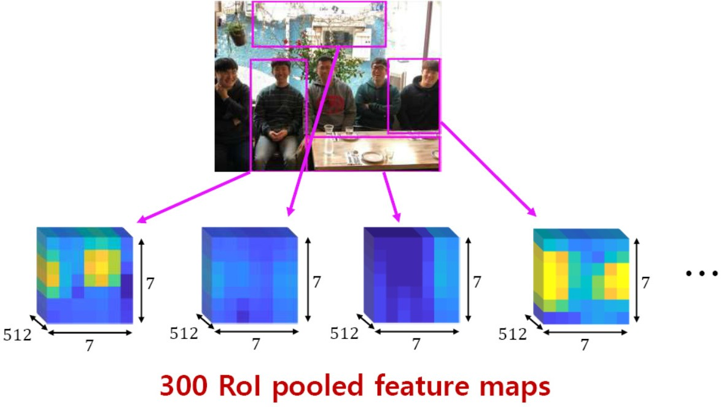
Faster R-CNN
Region of Interest Pooling

Slide 40
Faster R-CNN
Classifier + Regressor (R-CNN)
In the original Faster R-CNN paper, the R-CNN takes the feature map for each proposal, flattens it and uses two fully-connected layers of size 4096 with ReLU activation.
Then, it uses two different fully-connected layers for each of the different objects:
A fully-connected layer with N+1 units where N is the total number of classes and that extra one is for the background class
A fully-connected layer to predict the bounding boxes

Slide 41
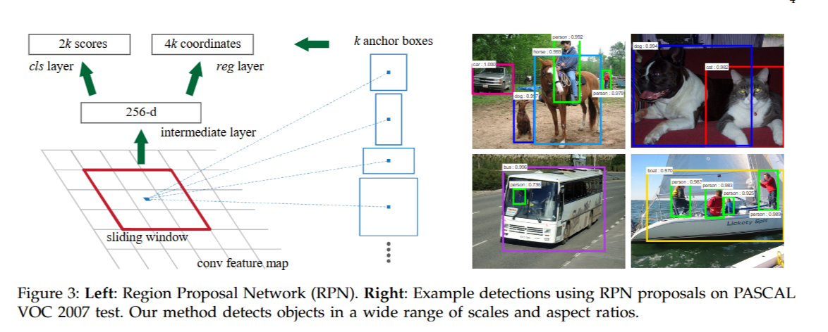
Faster R-CNN

Slide 42
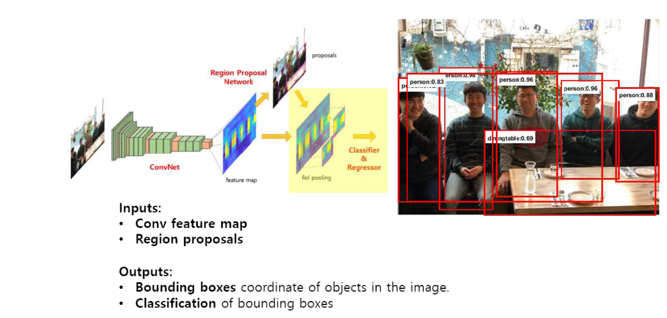
Faster R-CNN

Slide 43
Faster R-CNN: Targets
Targets for R-CNN are calculated in almost the same way as the RPN targets, but taking into account the different possible classes.
We take the proposals and the ground-truth boxes, and calculate the IoU between them.
Those proposals that have a IoU greater than 0.5 with any ground truth box get assigned to that ground truth.
Those that have between 0.1 and 0.5 get labeled as background.
Contrary to what we did while assembling targets for the RPN, we ignore proposals without any intersection.

Slide 44
Faster R-CNN: Training
Training Faster R-CNN is a little tricky and different from previous methods because RPN and Detection network when trained independently would set different weights for conv layers which would defeat the purpose of shared conv layers for reducing computation time.
Therefore authors proposed an alternating approach.

Slide 45
Faster R-CNN: Training
First RPN is trained and regions obtained are used to train detection network.
Then RPN is retrained but this time with the conv part initialized with weights from conv part of detection network.
In this run ,only the newly added conv layers(not being used in detection network) are fine-tuned for RPN and this makes the conv layers to have the same weights as detection network.
Finally the new RPN is used to generate the regions and fed to the training for detection network in which only the FC layers are fine-tuned. This is a like alternating optimization used in optimization problem involving two variables when fixing one variable converts the problem into an easy to optimize function dependent on second variable

Slide 46
Faster R-CNN: Training
In the original paper, Faster R-CNN was trained using a multi-step approach, training parts independently and merging the trained weights before a final full training approach.
Since then, it has been found that doing end-to-end, joint training leads to better results.
After putting the complete model together we end up with 4 different losses, two for the RPN and two for R-CNN. We have the trainable layers in RPN and R- CNN, and we also have the base network which we can train (fine-tune) or not.

Slide 47
Faster R-CNN: Summary
We take an image as input and pass it to the ConvNet which returns the feature map for that image.
Region proposal network is applied on these feature maps. This returns the object proposals along with their objectness score.
A RoI pooling layer is applied on these proposals to bring down all the proposals to the same size.
Finally, the proposals are passed to a fully connected layer which has a softmax layer and a linear regression layer at its top, to classify and output the bounding boxes for objects.

Slide 48
References
Faster R-CNN: Towards Real-Time Object Detection with Region Proposal Networks
Download Paper

Slide 49
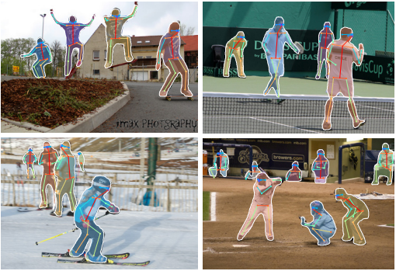
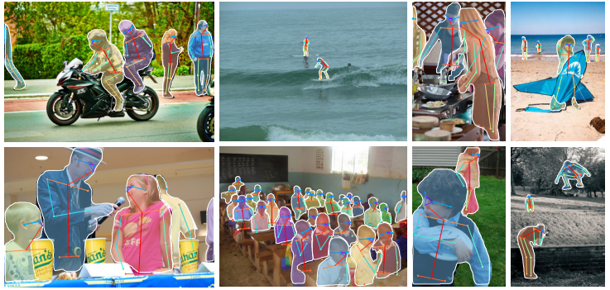
Reading Assignment: Read and Implement MASK RCNN
Mask R-CNN extends Faster R-CNN to solve instance segmentation tasks.
It achieves this by adding a branch for predicting an object mask in parallel with the existing branch for bounding box recognition.
Download Paper
Included in your exams

Slide 50
Thank You ☺

